Slide 1



Relatório de Vendas.DIO
View in Power BI
Last data refresh:
05/08/2024 04:50:47 UTC
Downloaded at:
05/08/2024 04:52:04 UTC

Slide 2
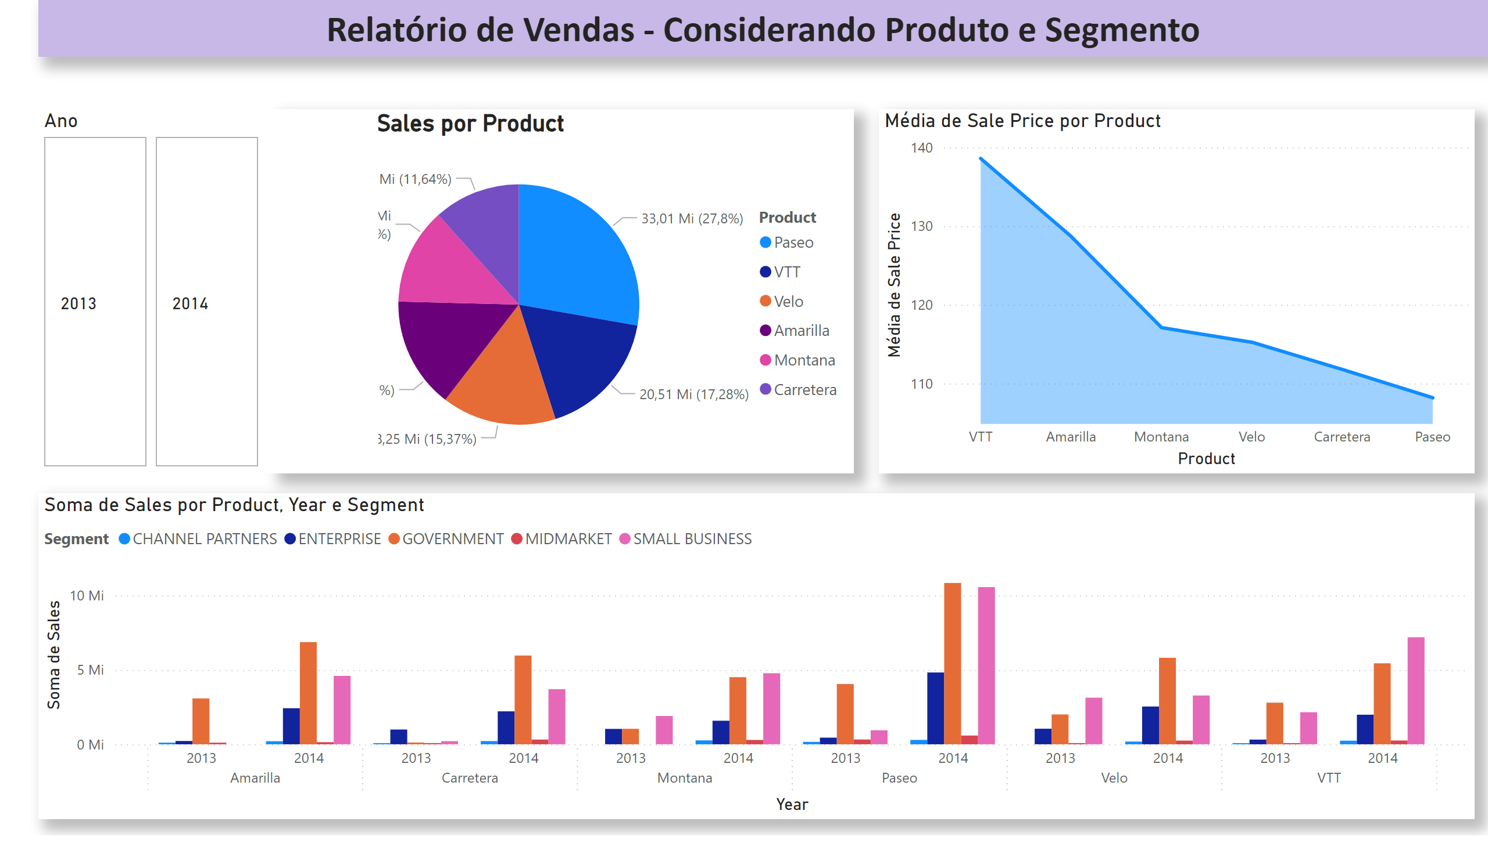
Página 1
Notes:
pieChart
No alt text provided
areaChart
No alt text provided
clusteredColumnChart
No alt text provided
advancedSlicerVisual
No alt text provided
textbox
No alt text provided

Slide 3
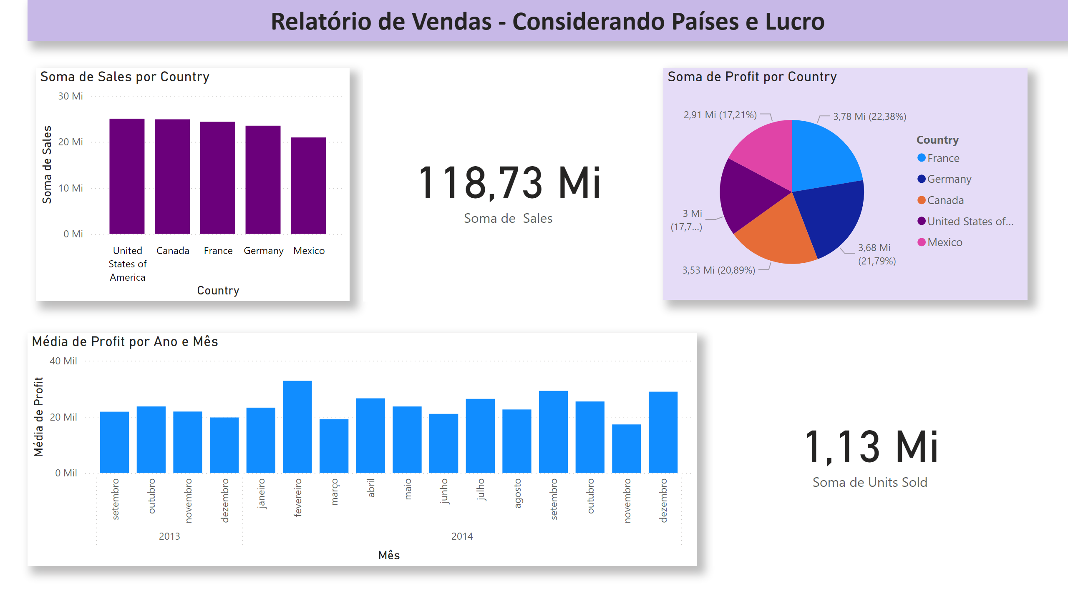
Página 2
Notes:
clusteredColumnChart
No alt text provided
card
No alt text provided
pieChart
No alt text provided
clusteredColumnChart
No alt text provided
card
No alt text provided
textbox
No alt text provided

Slide 4
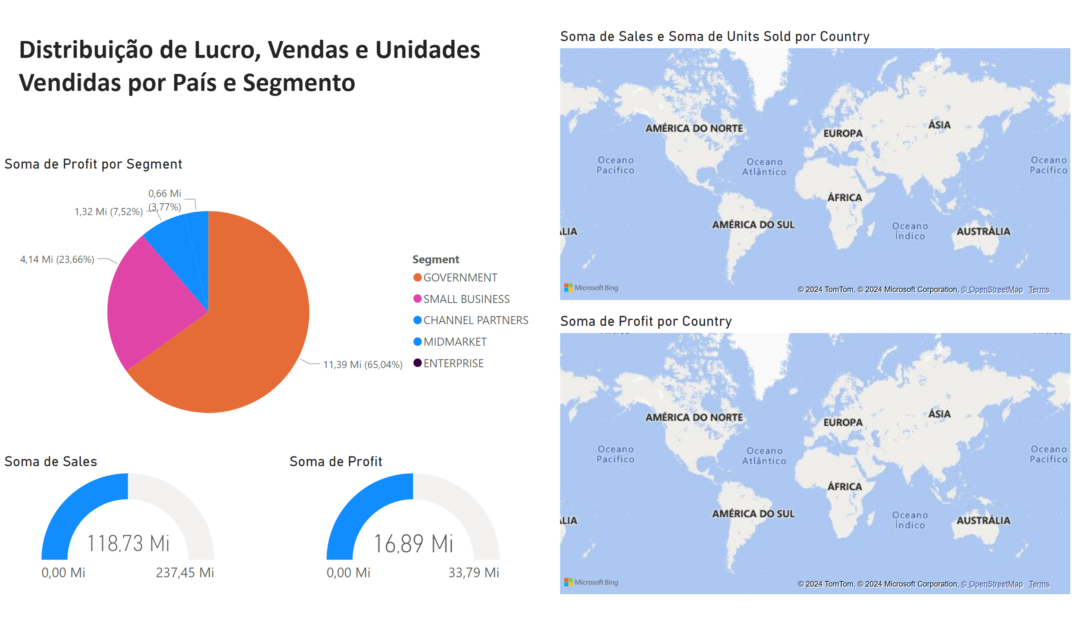
Página 3
Notes:
pieChart
No alt text provided
map
No alt text provided
map
No alt text provided
textbox
No alt text provided
gauge
No alt text provided
gauge
No alt text provided

